Slide 1
Platform Migration: Target 2022

Slide 2
How are ITS computing resources going to change in the next 5 years?
The Challenge
Notes:
This is the question that your experiment answers

Slide 3
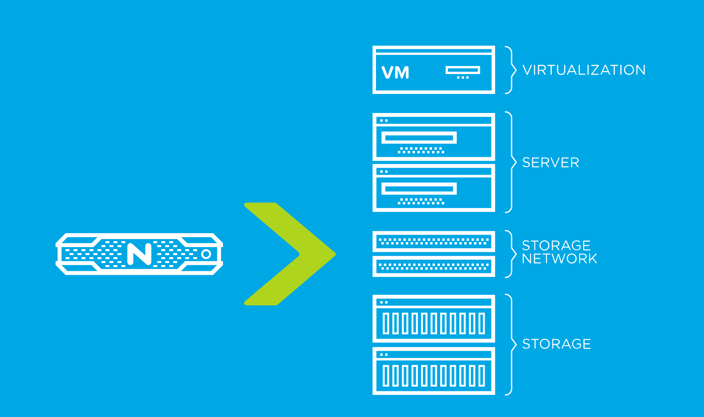
Current Status
ITS has a significant Virtualization infrastructure that is very good at providing infrastructure.
Our Virtualization stack comes from a time and place where technical debt lead to consolidation of storage, compute and networking.
But…

Slide 4
Bad Habits
No Catch Point for Requests or Participation from ITS
“Surprise, you’re getting a new app with these specs”
Anti-SaaS mentality
SaaS applications account for the cost of running a DC, engineers and support teams to keep the SaaS offering running. They are always more expensive because everything is costed.
Offering Infrastructure always will be cheaper to the customer because they’ve externalized the costs of the application on to ITS.
Lack of in-house application development support encourages customers to seek canned platforms and a “one-off” mentality
Notes:
Summarize your research in three to five points.

Slide 5

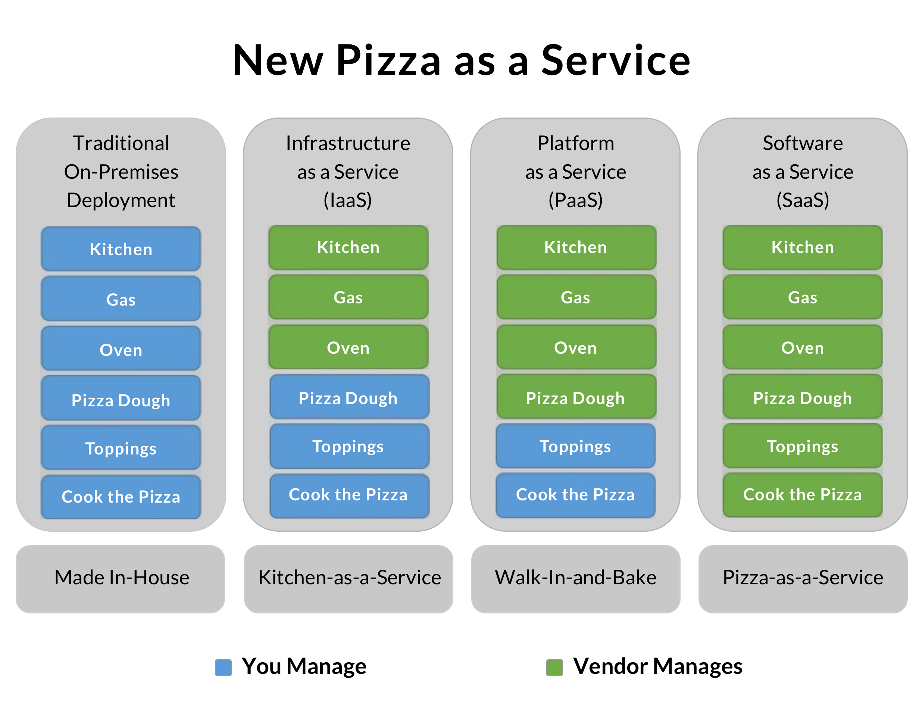
Deeper into the Environment
Modern Cloud Offerings have three tiers:
IaaS – Bare Metal, Infrastructure as a service, aka, VMs
PaaS – Platform, SQL “Service” or a Docker Swarm, aka bring your own pizza topping.
SaaS – Software Offering, Azure Functions, “Serverless”
ITS is good at pieces of this:
VMware for IaaS, supported by Nutanix
PaaS, Docker Enterprise
SaaS – Azure Functions for account automation

Slide 6
Cluster Provided Services
Current Service Platforms

Slide 7
Cluster Provided Services
On-Prem Provided Services
SaaS
Future Service Platforms

Slide 8
Service Migration in Steps
Distributed On Premise Services

Slide 9
Service Migration in Steps - LEAP
Distributed On Premise Services

Slide 10
Improved Habits
Direction:
Move Services out of the Virtualization Stack to reduce cost on Hardware & Software, and reduce providers
Virtualization
Nutanix
Hardware Support
Software Support
VMware
Software Support
Docker – Just Software
Pick a hardware platform (Cisco, HP, Lenovo, SuperMicro)
AzureStack Hub
Hardware & Software (Cisco, HP, Lenovo)
Operational Costs as we age away from traditional HCI
IaaS, SaaS and PaaS offerings
Direct to Cloud

